Slide 1
Sentiment Analysis of YouTube comment using MapReduce
Vinay Reddy Polati
Brahmachaithanya Sadashiva

Slide 2
Contents :
Motivation
Related works and differences
Problem Statement
Design
Contributions
References

Slide 3
Why YouTube Comment Sentiment Analysis ?
The number of people who are using YouTube are growing in rapid phase and as of March 23rd 2017 total number of users are :1,300,000,000.
Almost 5 billion videos are watched every day and in US it’s the second largest social media website after facebook accounting over 22% of social media traffic.
YouTube is used as a Launchpad by different companies and musicians for their products and services.
Users reaction to the videos can be analyzed to get more insights to the video as a feedback.
There is a need for a parallel and distributed system like Hadoop to analyze and understand the activities.

Slide 4
Related Works and Differences
A data mining based spam detection system for YouTube :
http://ieeexplore.ieee.org/document/6694038/
Sentiment Analysis of Twitter Data
http://www.pnrsolution.org/Datacenter/Vol3/Issue6/18.pdf
Comments ,replies and likes for a specific comments are considered to generated the sentimental index.

Slide 5
Problem Statement
Likes and View counts doesn't give more insight about the Video.
Difficult to deduce the user reaction by manually analyzing the comments.
Sentimental analysis helps to systematically identify, extract, quantify, and study affective states and subjective information.

Slide 6
Data Set
Data set is extracted using YouTube Data APIs
Comments are retrieved using :
Services > YouTube Data API v3 > youtube.commentThreads.list
Region of each users retrieved using :
GET https://www.googleapis.com/youtube/v3/search

Slide 7
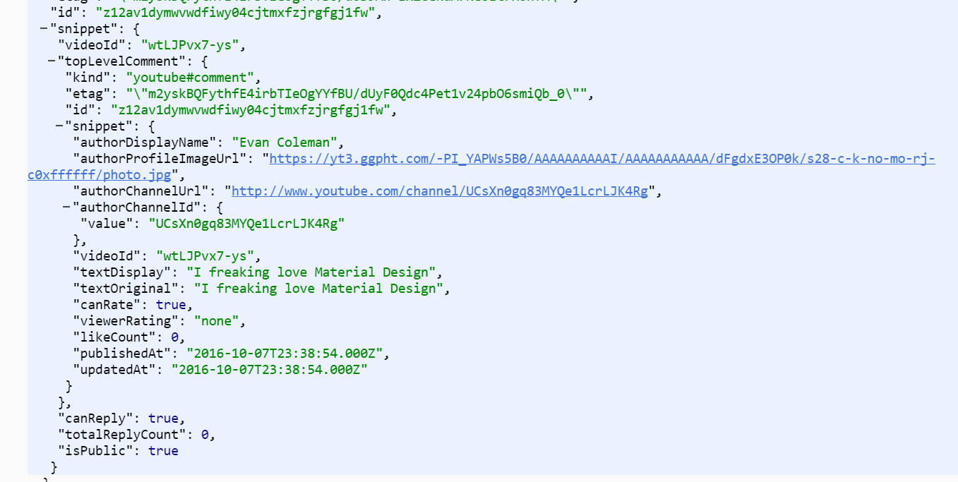
API result Json for comments Query
Fields needed :
“textOriginal”
“authorChannelID”
“VideoID”

Slide 8
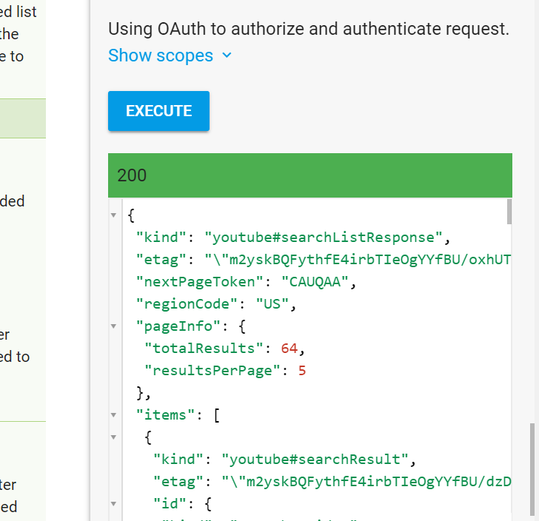
API results for location Query for a specific user

Slide 9
Design :
Extract the data using YouTube APIs :
Data Pre-processing :
Ignore the comments which are not useful for the analysis like Emoji's and URLS .
Comments and replies of the video publisher.

Slide 10
Sentiment Analysis :
Mapper :
Staging of the data.
Map the comments for each regions.
UserId | Comments | Region | CommentLikesCount
Vrpolati | w1 w2 w3 w4 w5 | Ind | 132
122@vrtz | w6 w7 w8 w9 w10 | Unites States | 65
3weZw | w11 w12 w13 w14 | China | 123
12@789 | w15 w16 w17 w18 | United States | 12
Reddy# | w19 w20 | Ind | 4589

Slide 11
Find the polarity :
Reducer :
Tokenization :
Split each words of the comments to different tokens.
Normalization:
Filter tokens by doing lookup to different dictionaries like Lexical Dictionary ,Acronym Dictionary ,Stop Words Dictionary

Slide 12
Categories :
Positive, Negative and Neutral.
Identify the sentiment using the below formula
Sentiment Index(SI) =
(#positive word - #negative words) /
(#positive words + #negative words)

Slide 13
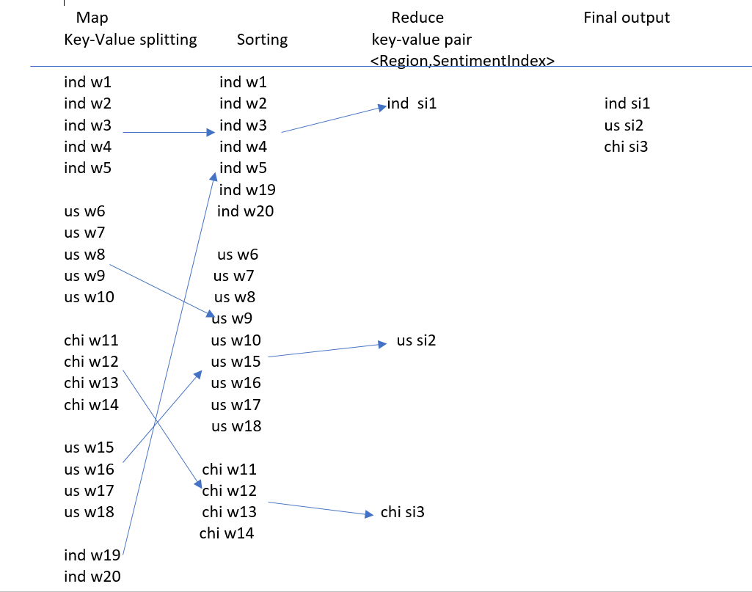

Slide 14
Going Forward:
Capture the sentiments by combining different attributes like view time and date .
Live feed of the reactions.
Can be used to identify click baits/spams.

Slide 15
Contributions:
Brahma :
Extraction and preprocessing of comments data.
Implementation of mapping phase
Vinay :
User data gathering and preprocessing.
Reducer phase implementation.

Slide 16
References :
http://www.pnrsolution.org/Datacenter/Vol3/Issue6/18.pdf
http://ieeexplore.ieee.org/document/6694038/
http://ieeexplore.ieee.org/document/7784953/
http://ieeexplore.ieee.org/document/6316715/

Slide 17
Thank You !!!

